Slide 1
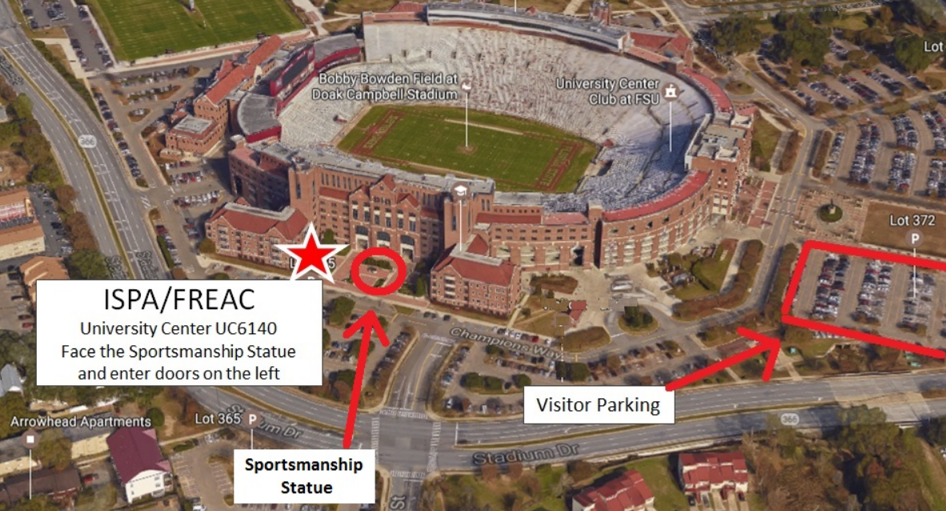
Florida Resources and Environmental Analysis Center (FREAC)
Stephen Hodge
Georgianna Strode
Michael Core
Beverly Renard
What is FREAC and how can it help me?
Seven Hills Regional User Group (SHRUG)
Annual Conference November 2021

Slide 2
This presentation will cover
How/Why FREAC was Formed
What we offer
Services
Data
Work Samples
How to Download Data

Slide 3
How we were started
Natural Resource Committee (of the Florida Legislature) had Questions
Where do we own land
Where are the “natural” areas in Florida
Where do we need updated maps (1967 - USGS)
GNIS - Geographic Names Information System
NWI - National Wetland Inventory
EDB - Ethylene Dibromide
Florida Population was 6.7 million (now ~21.5 million)

Slide 4
History of ispa/freac
The Institute of Science and Public Affairs (ISPA) was created through consolidation of several university-wide outreach groups
The Florida Resources and Environmental Analysis Center (FREAC) was the original Center within ISPA (1969).
FREAC is an applied research center
Provides advice and technical assistance to state and local agencies.
Connects academic, public, and private organizations.
Promotes collaboration faculty, staff, and students.
Trains university students through direct involvement in projects (real-world experience).
Research:
General areas of resource management and environmental analysis.
Public lands research and analysis.
GIS development.

Slide 5
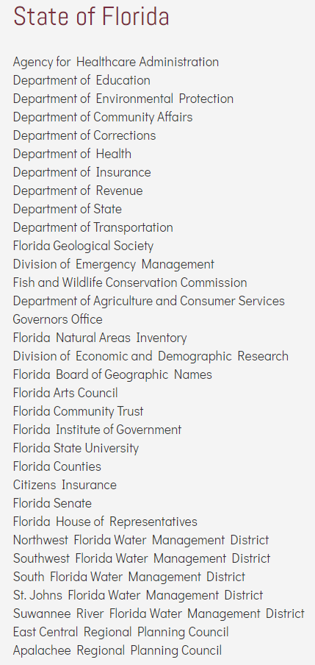
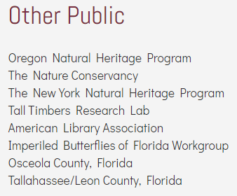
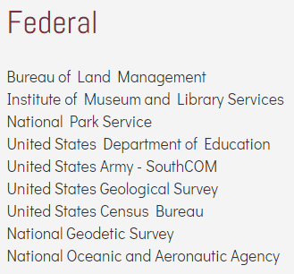
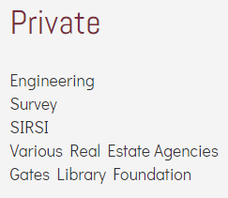
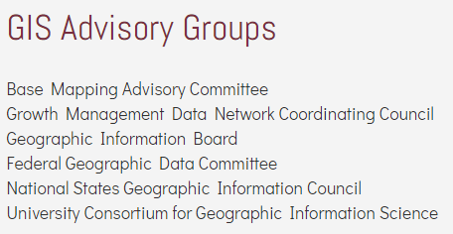
Entities FREAC has worked with
Notes:
FDOH, Florida Afterschool Network, real estate mapping, is there a specific group for asset naming/using?

Slide 6
Organizing GIS in Florida
Growth Management Data Coordinating Committee (1985-87)
Base Mapping Advisory Committee (BMAC 1989 – mid 1990s)
Geographic Information Board (GIB mid 1990’s - 2005 )
Geographic Information Advisory Committee (GIAC)
Florida Geographic Information Office (2018-present)
National States Geographic Information Council (NSGIC)
Water Management District GIS Managers (1986-present)

Slide 7
Freac’s core strengths
GIS
Programming / Web Applications
Cartography / Graphic Design
Bayesian Network Analysis
Geologic Analysis
Socioeconomic Analysis
State Land Research
U.S. National Grid (USNG) Applications

Slide 8
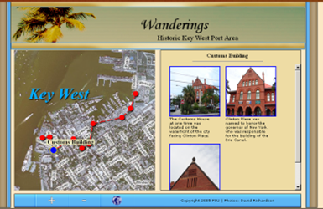
Established 1987 to promote geographic literacy by fostering innovation in geographic education and encouraging the protection and conservation of Florida’s natural and cultural resources.
Purpose of Above Map:
Make a local homework assignment
More visually accessible to students.
Unintended Effect:
Tourism, discussion on oral history projects

Slide 9
Florida natural areas inventory (fnai)
One of the first statewide
Online conservation
Lands maps. 2005
1964 – Land Acquisition and
Trust Fund (LATF) 1972 - WMD 1979 – Conservation and
Recreation Lands (CARL) 1989 – Preservation 2000 1998 - Florida Forever

Slide 10
Current Freac projects
Florida Department of Environmental Protection (FDEP)
Land Boundary Information System (LABINS)
Public Lands Inventory (PLI)
Florida Department of Health (FDOH) Community Health Explorer
FSU College of Medicine
Legislative Precinct Mapping / Reapportionment
Resilient Infrastructure for a Net-Zero Florida Panhandle
Notes:
It would be good to list all the projects that you are showing examples of later in the presentation. College of Medicine – Maternal Mental Health (ask Stephen about this one – he might not want to show it), iMap Invasives, Precinct mapping/Reapportionment/census, southcom…

Slide 11
History of LABINS
1977 - Legislation created Chapter 177, Part III, F.S.
Required surveyors to report survey of Certified Corners to the Florida Department of Environmental Protection, Bureau of Survey and Mapping
1984 – FDEP realized they could save money by allowing surveyors to query data
Funded by the Florida Department of Environmental Protection
Created a program to distribute survey data to surveyors
Data Distribution Methods have included:
Phone lines using 300-baud modem (followed by 1200- and 2400-baud)
5.25” floppy disks; 3.5” floppy disk; CD ($75 charge to surveyors)
1996 World Wide Web – This method allows unlimited distribution of images and has contributed greatly to LABINS’ popularity
Results
Primary function is a database for Certified Corner Records (115,000 records)
The ONLY website of its type
Largest collection of no-cost data to the public
Users began as surveyors and now include engineers, outdoor enthusiasts, historians, property appraisers, real estate agents, lawyers, and others.

Slide 12
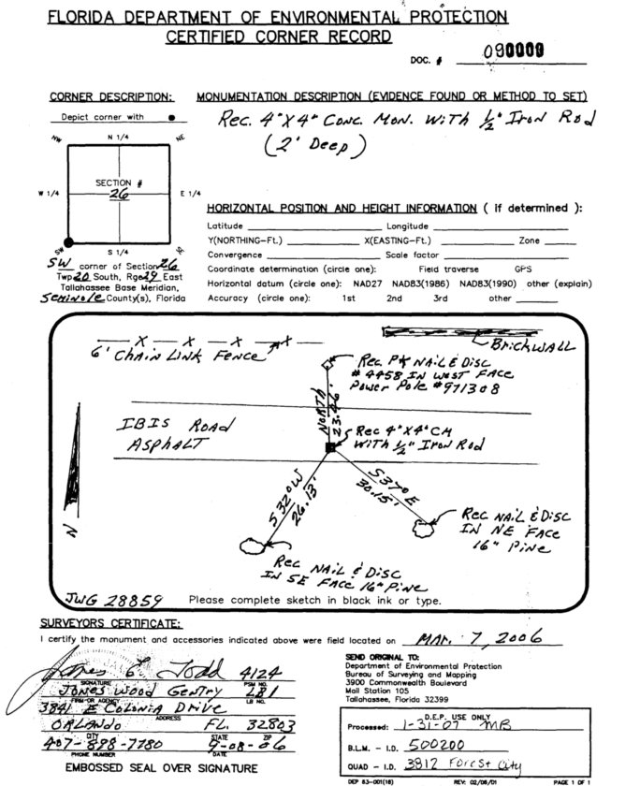
Land Records: Certified Corners
Began collection in 1984
Over 115,000 corners collected
Average of 1,000 new records per year

Slide 13
Overview of data & services available
Is any of this out of date???
Survey Data
Mapping Data
Land Records
Certified Corner Records – 1984 to present. 115,000 records.
GLO 1824 General Land Office Notes & Plats. 145,000 images.
Horizontal/Vertical Control
NGS Data directly from NGS
FLDEP Benchmarks (unpublished NGS field data)
Water Management Districts & Counties
Water Boundary
Tide Stations
Erosion Control Line Index and Maps
Mean High Water Survey Index
FLDEP Coastal Construction Control Line - 350 maps
DEM – Digital Elevation Model
DLG - Digital Line Graphs – 5300 data sets
DRG - Digital Raster Graphics – 3400 images in 3 projections
DOQQ Digital Ortho Quarter Quads 1995, 1999, 2004
80,000 images
3 different flight years
3 projections for each flight year,
1-3 file formats for each projection
Hi-resolution Aerials
Currently 900,000 images available (16 yrs)
We acquire approximately 60,000 new images every year.
Services
Geographic Profile
Metadata Clearinghouse

Slide 14
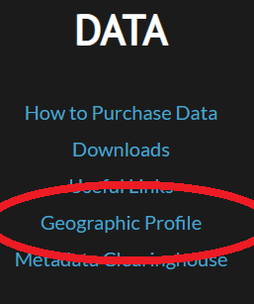
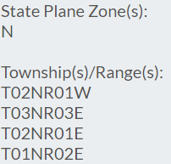
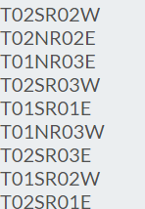
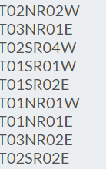
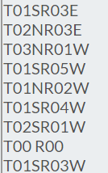
Labins geographic profile
To find the Geographic Profile, scroll to bottom of any LABINS page
If you know one piece of information, you can know ALL info!
A search on Leon County:
I know my T-R-S,
But what Quad
Am I in?
I’ll use the Geographic
Profile to find out!
Possible Inputs:
County
City
Quad
T-R-S
US National Grid
Lat-Lon
Dec Degree
State Plane
UTM
Albers
Geographic Names (GNIS)

Slide 15
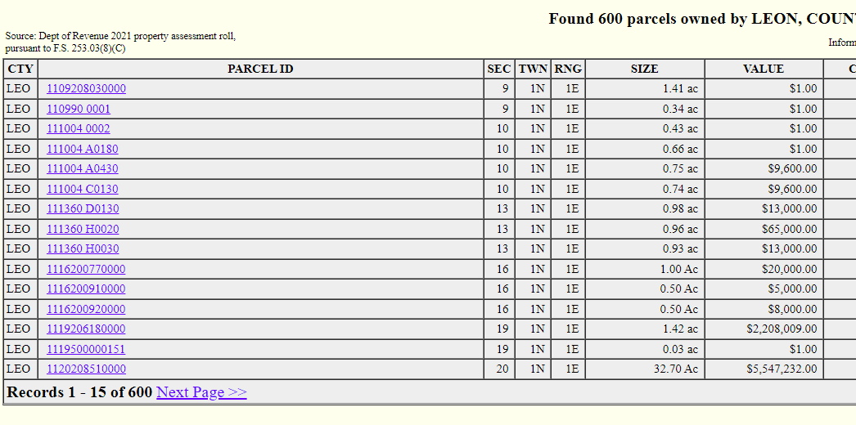
Florida DEP Public lands inventory
https://floridapli.net
Colors represent federal, state, municipal, and
Other ownership

Slide 16
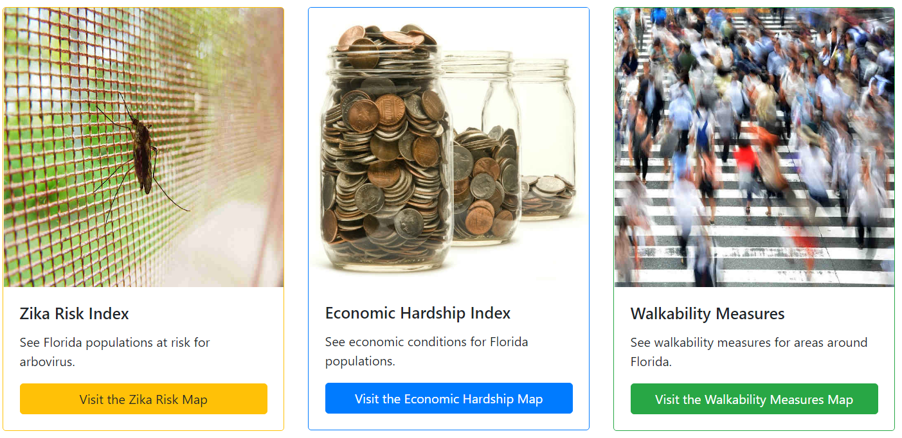
FdOH community health explorer
http://hermes.freac.fsu.edu/che/
Florida Health’s Environmental Public Health Tracking Program works in partnership with the US Centers for Disease Control and Prevention to track disease that may be related to environmental exposures.
Notes:
FDOH, not FDEP

Slide 17
Census and Reapportionment
FREAC did the precinct mapping project to aid the Legislature in reapportionment in 2000, 2010, and 2020
Notes:
Highlight that FREAC did the precinct mapping project to aid the legislature in reapportionment in 2000, 2010, and 2020. Also might check with Stephen as to what to call it – precinct mapping or just reapportionment

Slide 18
Selected Past projects
iMapInvasives (Nature Conservancy, NY and Oregon Natural Heritage Programs)
Emergency and Natural Disaster Information System (US Army Southern Command)
Friends of Wakulla Springs
Cape Canaveral Volunteer Fire Department
FDOH Walkability Assessment
… and more

Slide 19
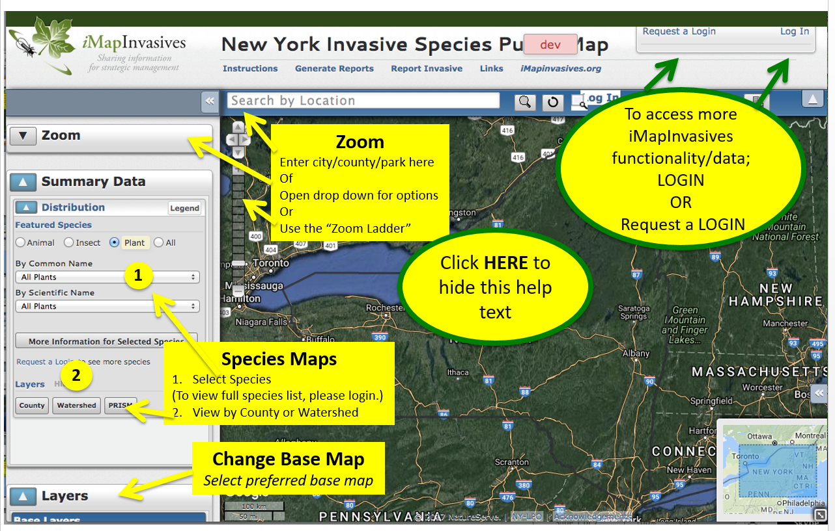
iMapInvasives
The Nature Conservancy,
New York Natural Heritage Program,
Oregon Natural Heritage Program
iMapInvasives provides an on-line,
GIS-based data management system to assist citizen scientists and natural resource managers working to protect natural resources from the threat of invasive species.

Slide 20
Integrated Decision Support System (IDSS)
US Army Southern Command
Decision tool to support
Responders before, during,
And after storms
FSU Collaborative Effort

Slide 21
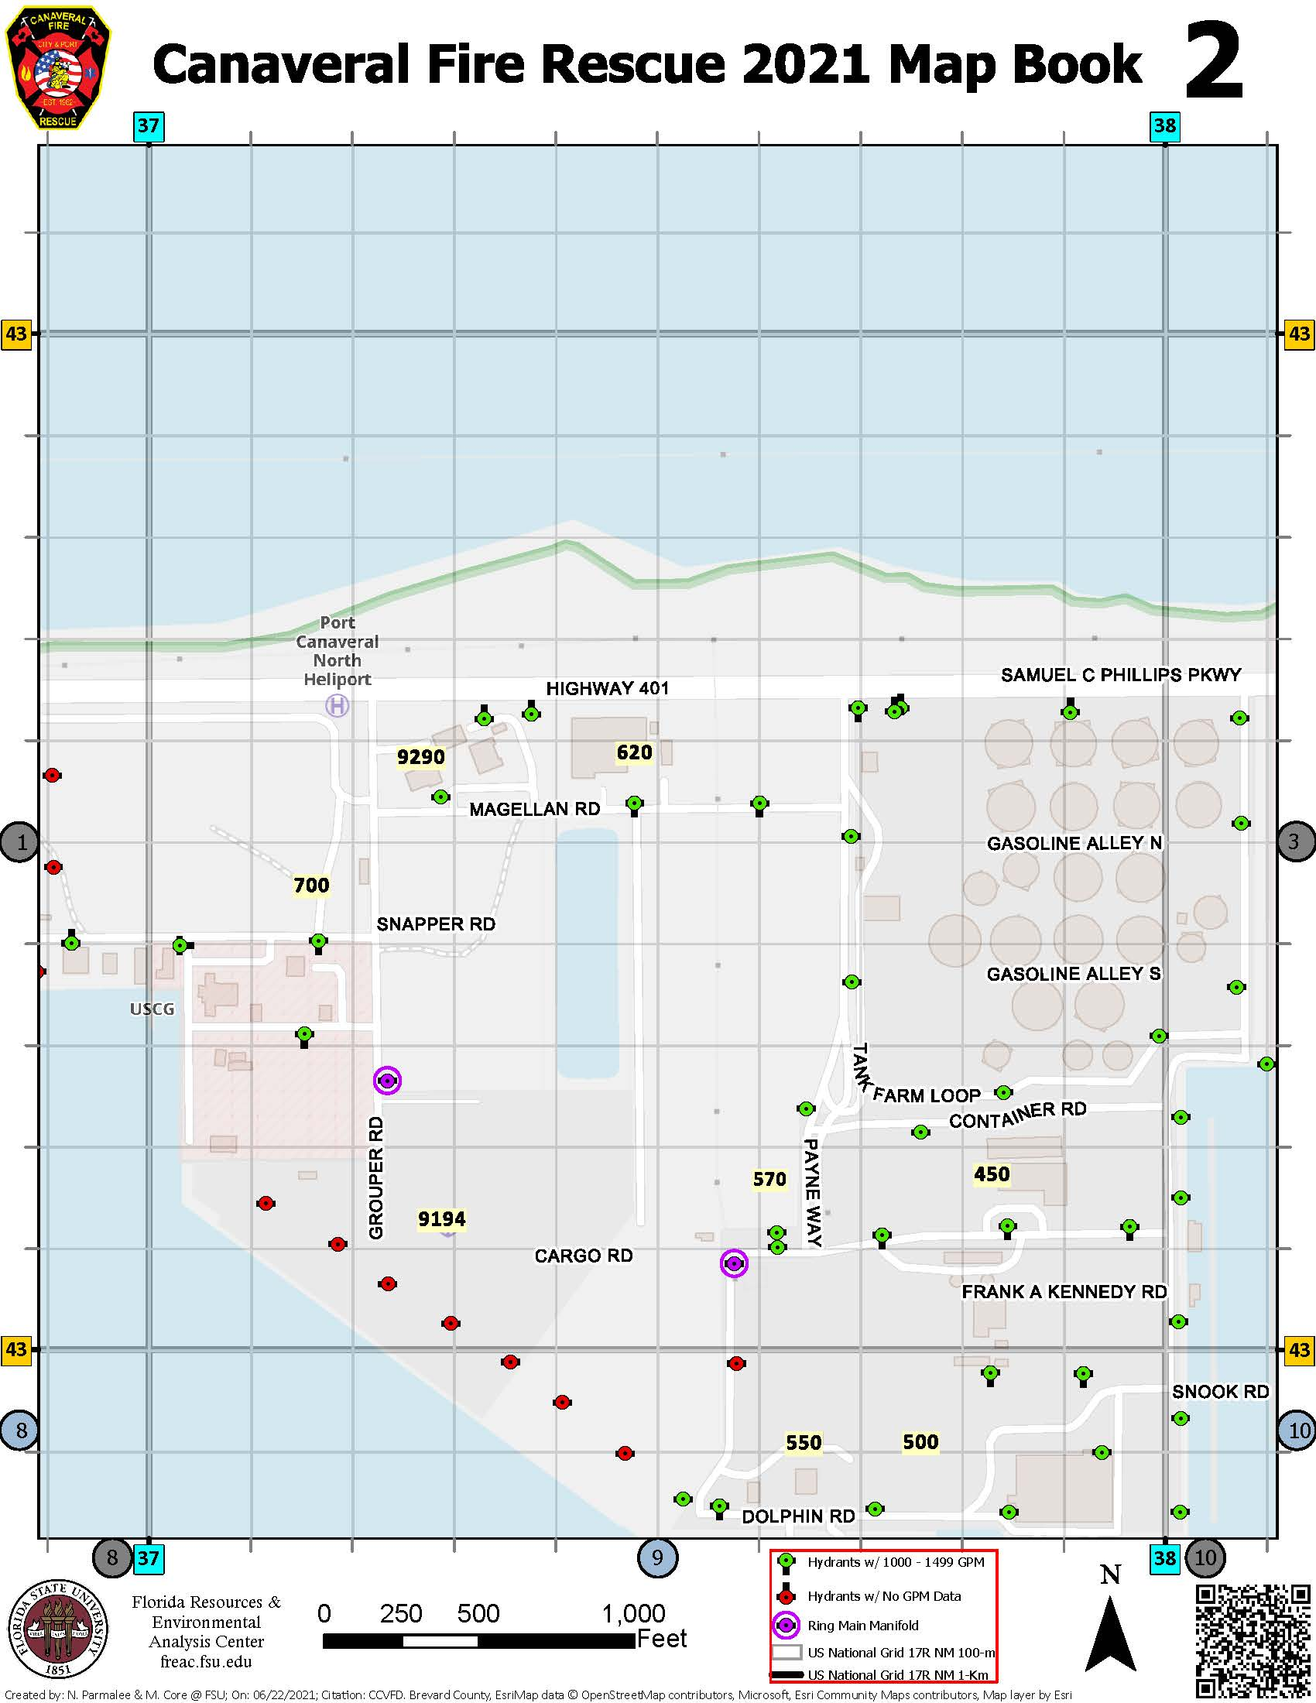
Cape Canaveral volunteer fire department
The US National Grid is the FEMA mandated coordinate-language of location and is Crucial for SAR missions.
The Volunteers at the CCVFD were working with outdate and erroneous fire hydrant maps.
The Firefighters will have update-to-date information on paper, web, and in their phones.
The new maps are based on the USNG.

Slide 22
Recent research interests

Slide 23
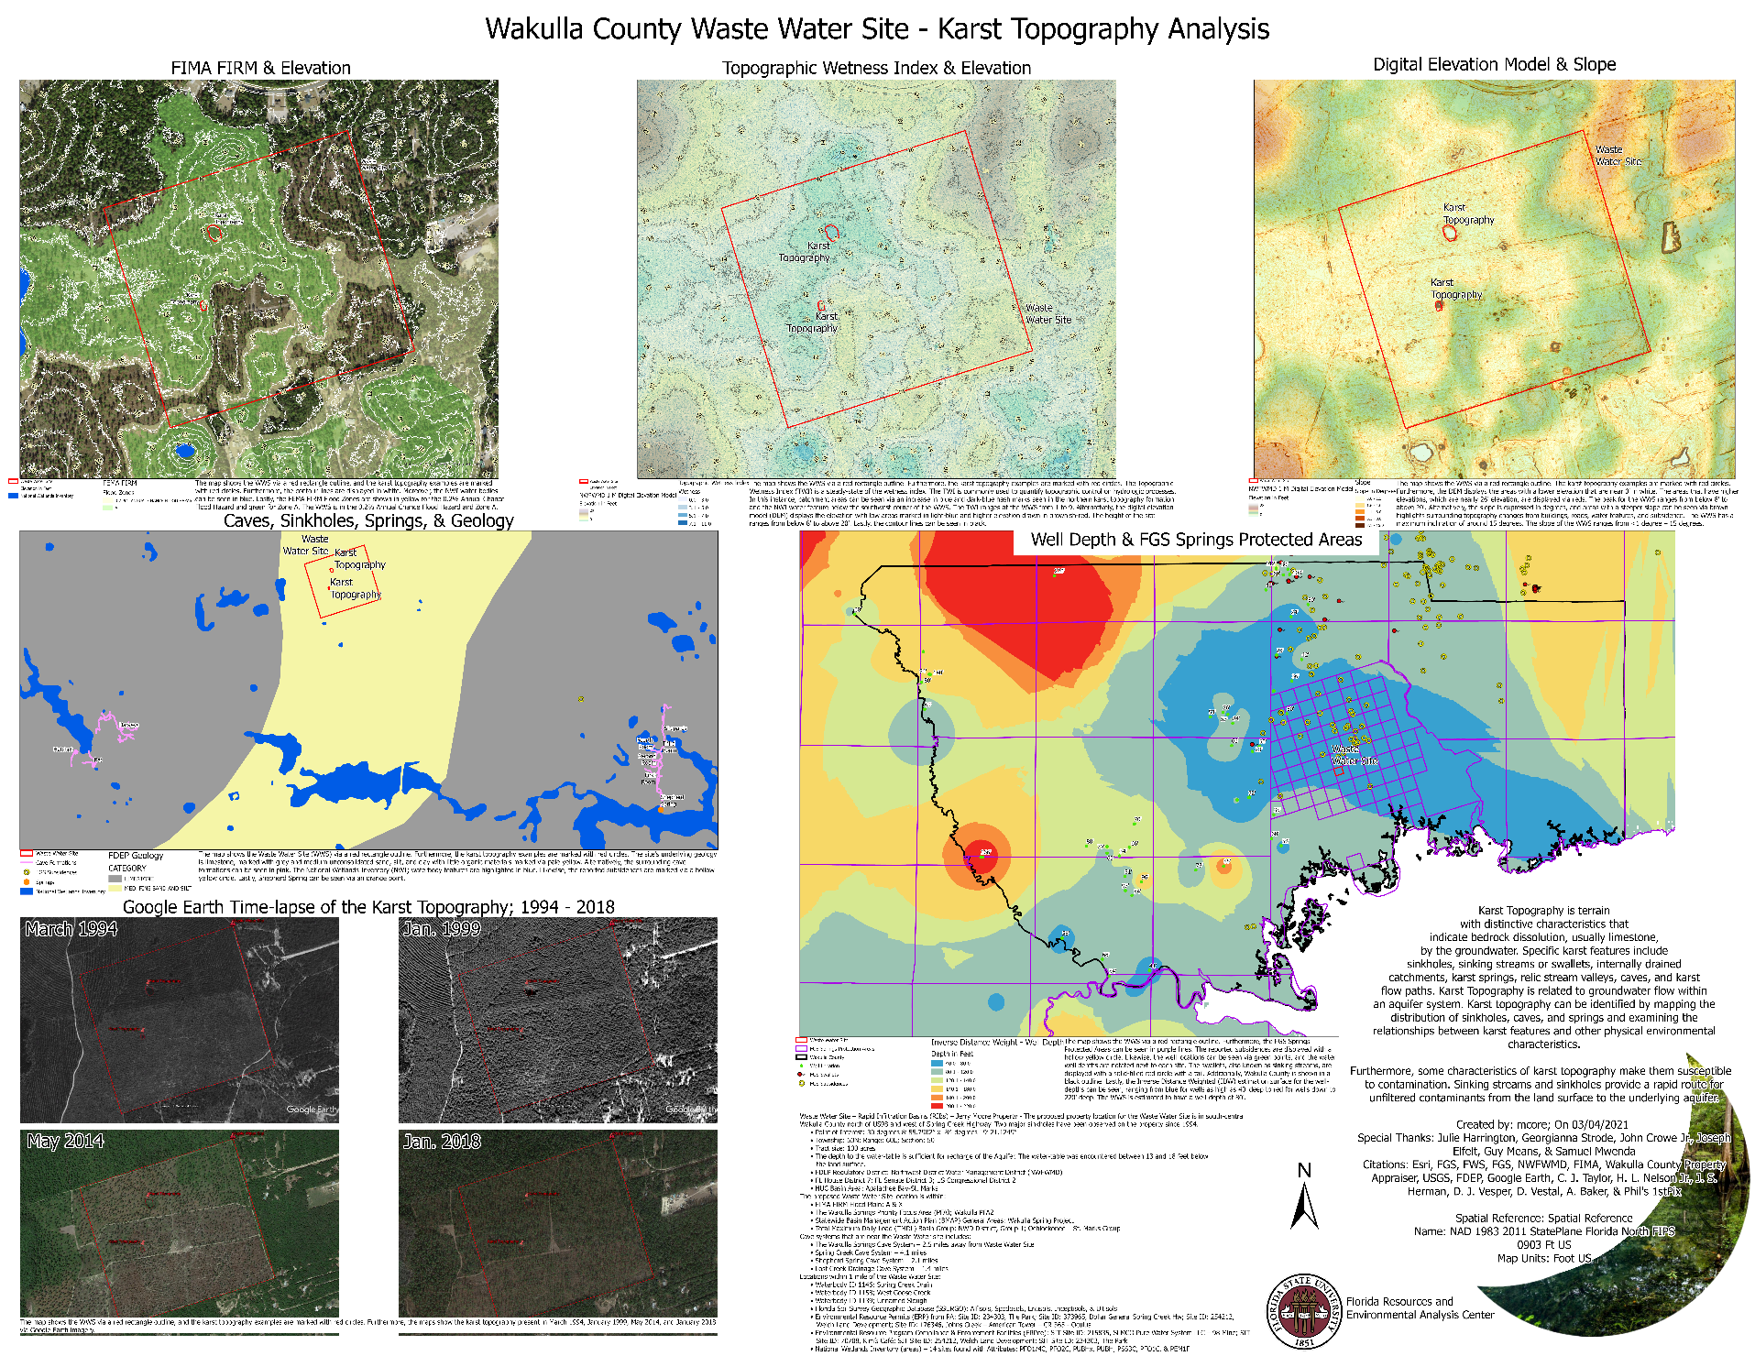
Geology assessment – Wastewater Site
Wakulla Springs Alliance
Rapid Infiltration Basin & Karst Topography
Karst Topography is terrain that indicate bedrock dissolution (limestone).
Karst Topography is related to groundwater flow within an aquifer system.
Some characteristics of karst topography make them susceptible to contamination.

Slide 24
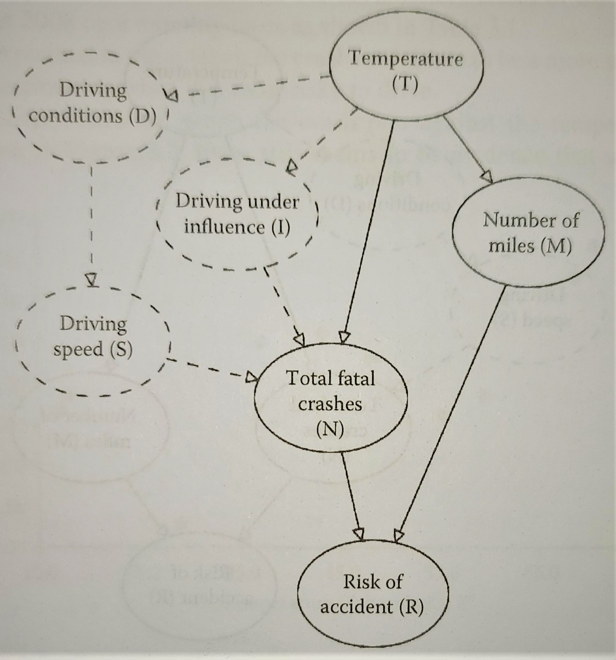
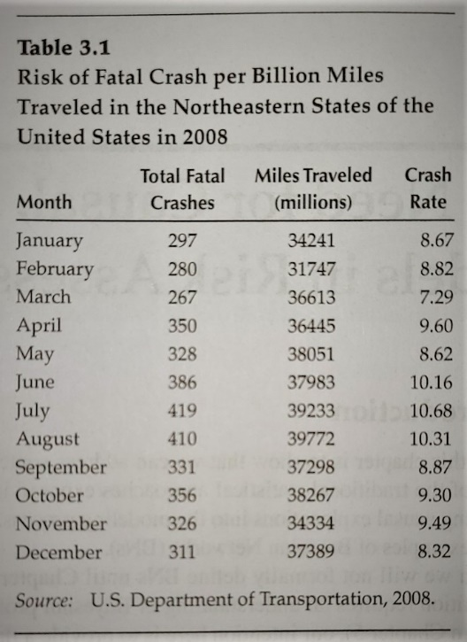
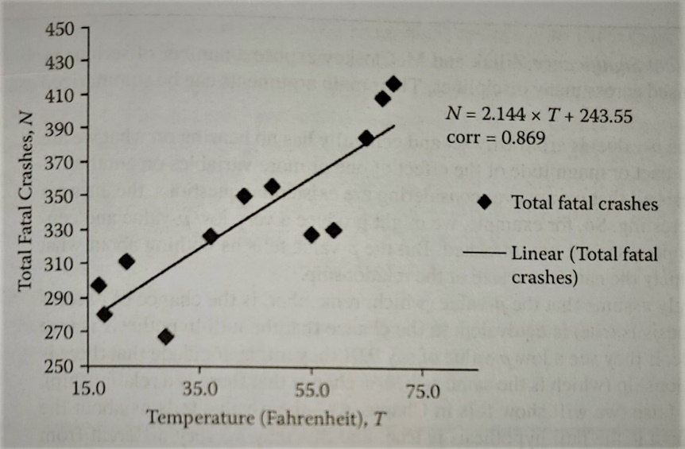
Bayesian analysis
Bayes’ Theorem is a general expression for finding conditional probabilities developed in the 1700s.
Bayesian Networks are used for medical diagnosis, counter-terrorism, risk analysis, fraud, software debugging, etc.
Bayes’ Theorem rests on the causal connection of events and beliefs (Fenton and Neil 2013).
Correlation ≠ Causation
p-value 0.01 ≠ 99% Chance of a Relationship
(Fenton & Neil, 2019)

Slide 25
Bayesian analysis
Moving analysis results from a BN to a GIS allows for probabilistic maps based on Bayesian inference findings.
BNs allow for data exploration and verification far beyond the capabilities of p-scores and regression lines.
“Lights-Out After Hurricane Michael: A Spatially Informed Bayesian Network Analysis of Power Outages” – Southeastern Geographer, Issue 62.2 (2022).
Areas with deciduous forest land cover experience fewer decreases in nighttime lights.
When buildings are near electric substations, there is an overwhelming decrease in significant power outages.

Slide 26
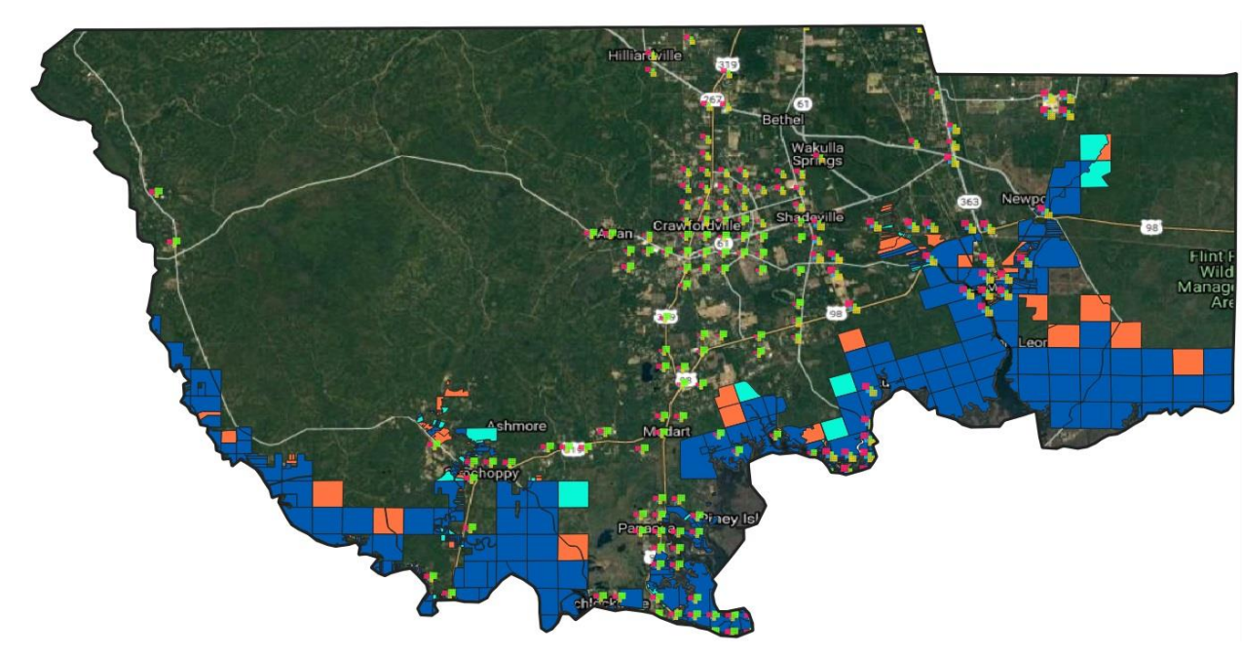
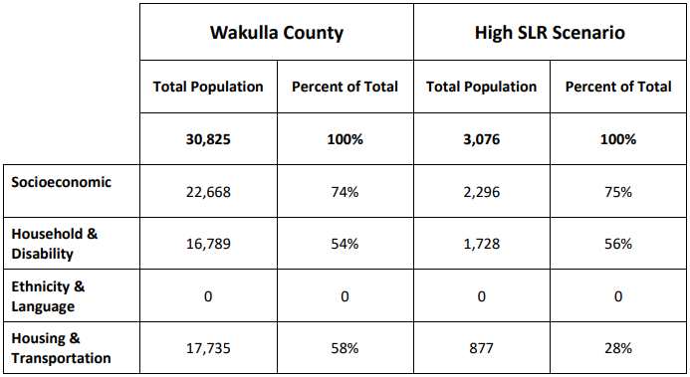
Sea level rise assessment
Sea Level Rise Impacted Parcels and Social Vulnerability Index
Land parcel analysis shows properties of various land use types totaling $200 to $300 million in just value in today’s dollars.
Inland communities have nearly twice the amount of housing & transportation vulnerability than coastal areas.
Our 1-km gridded population data is an improvement over census tract population mapping by providing a clear view of residential areas and social vulnerability measures.
Evaluating multiple social vulnerability themes instead of a singular index allowed detection of a variation in the housing & transportation category.
We hope that our research furthers interest in fine-grained assessments to reveal data patterns that might otherwise be masked.
A Sea Level Rise Assessment of Wakulla County, Florida
Will Strode, Mike Core

Slide 27
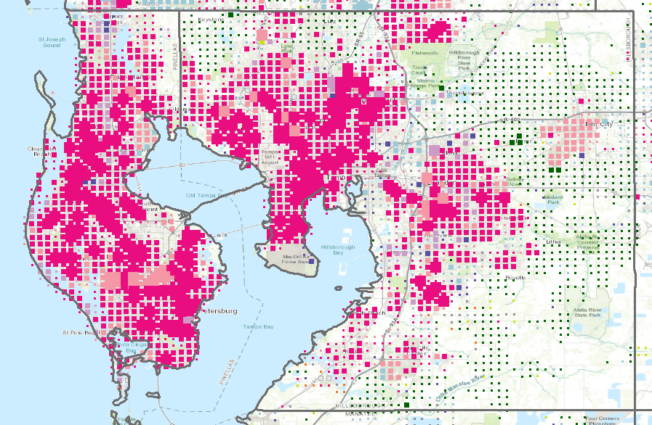
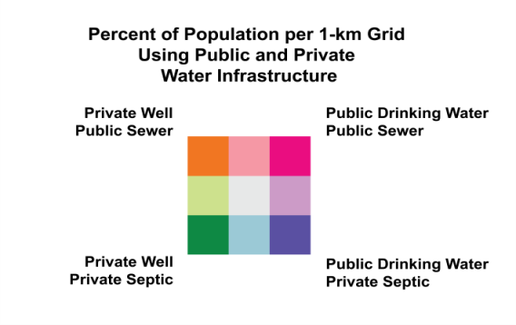
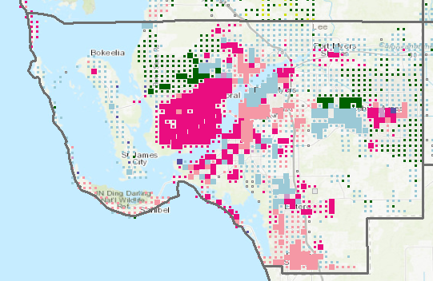
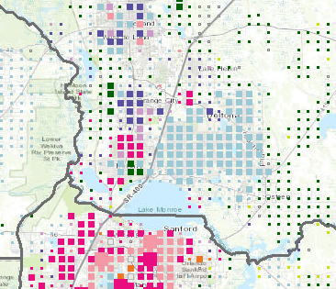
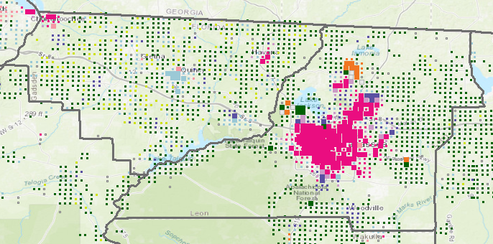
Public/private drinking/wastewater
Pinellas and Hillsborough. 1:400,000.
Charlotte County, 1:600,000.
Gadsden and Leon Counties. 1:600,000.
Sanford and vicinity. 1:400,000.

Slide 28
data

Slide 29
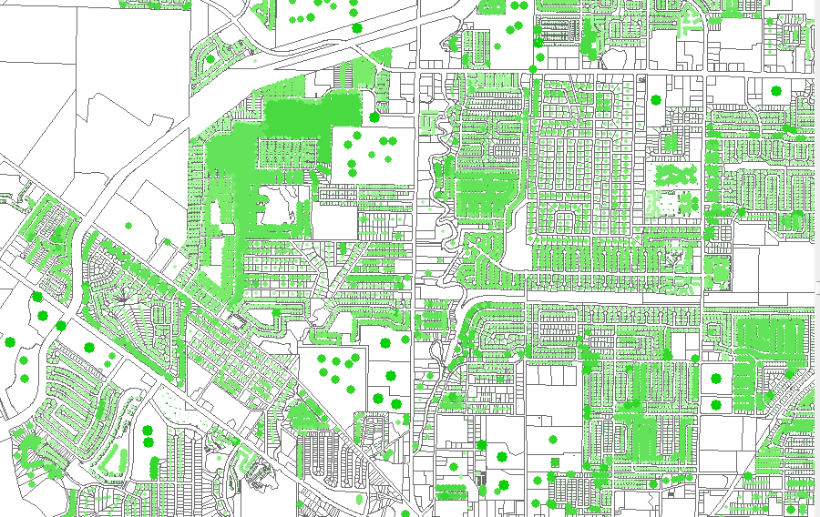
Parcel-based dasymetric population estimates
Ingredients: Census Data + Group Quarters + FDOR Property Appraiser
How many people live
in the flood zone?
How many people
live near the landfill?
Improving Dasymetric Population Estimates for
Land Parcels: Data Pre-processing Steps
G. Strode, V. Mesev, and J. Maantay
Southeastern Geographer, Volume 58, Number 3, Fall 2018
Splitting Census Tracts (top down) to estimate population often results in undercounts.
A better method is to sum population estimates at the property parcel scale (bottom up)
to fit your geographic boundary.

Slide 30
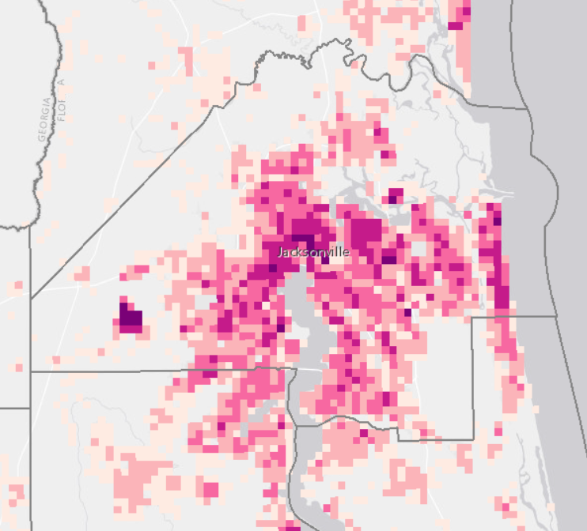
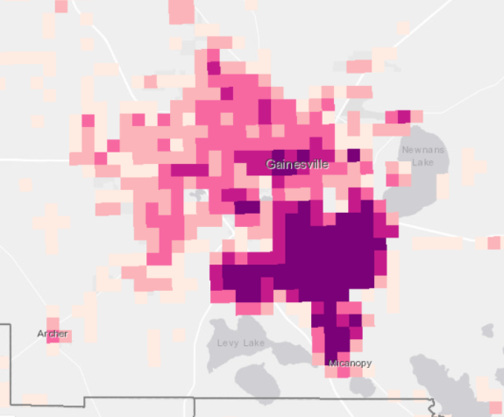
Walkability
Bureau of Chronic Disease Prevention
Division of Community Health Promotion
Florida Department of Health
https://hermes.freac.fsu.edu/che/walk/
Jacksonville
Gainesville

Slide 31
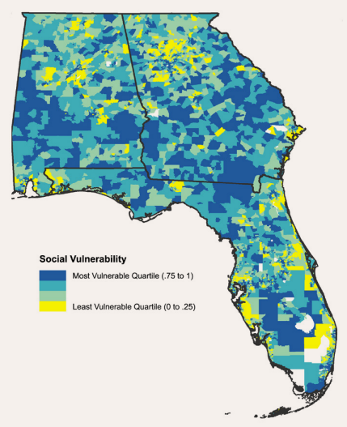
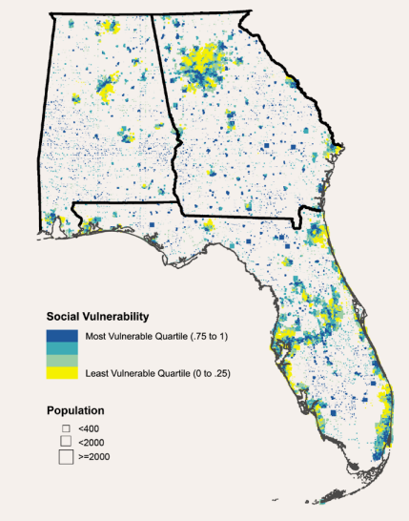
Social vulnerability
Filter data through a population grid to remove unpopulated areas.
Map becomes bivariate because It is showing original data PLUS population density.
Univariate Map
Bivariate Map
Exploratory Bivariate and Multivariate Geovisualizations of a Social Vulnerability Index
G Strode, V Mesev, S Bleisch, K Ziewitz, F Reed, J.D. Morgan
Cartographic Perspectives, Number 95, 2020
Notes:
Add FDOH Community Health Explorer

Slide 32
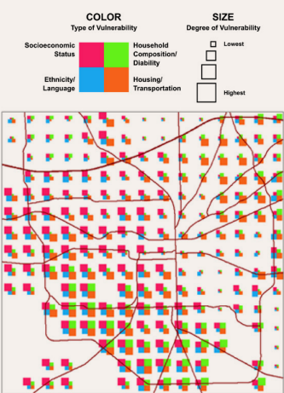
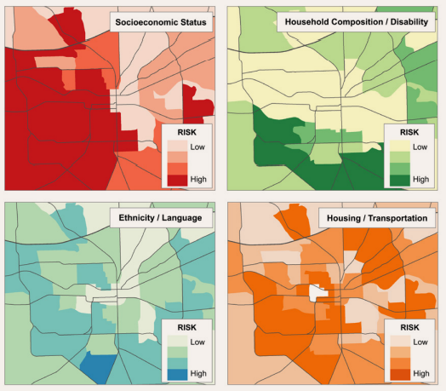
Social vulnerability multivariate
Exploratory Bivariate and Multivariate Geovisualizations of a Social Vulnerability Index
G Strode, V Mesev, S Bleisch, K Ziewitz, F Reed, J.D. Morgan
Cartographic Perspectives, Number 95, 2020

Slide 33
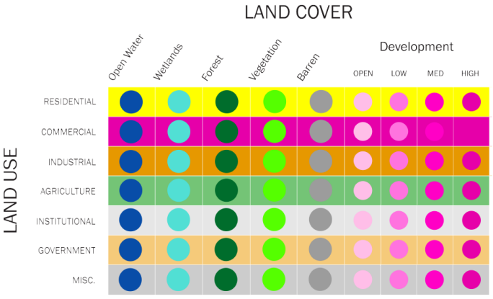
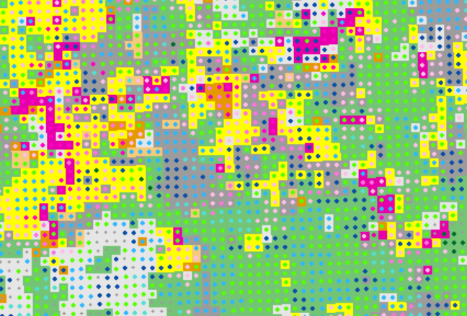
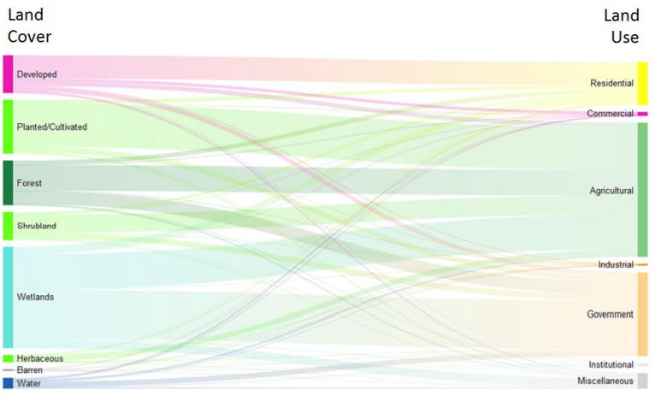
Land use land cover geovisualization
G. Strode, V. Mesev, B. Thornton, M. Jerez, T. Tricarico, T. McAlear
Geovisualization of Florida Land Use and Land Cover using Bivariate Mapping, Statistical Legends, and Visual Analytics
The Florida Geographer, 2018.

Slide 34
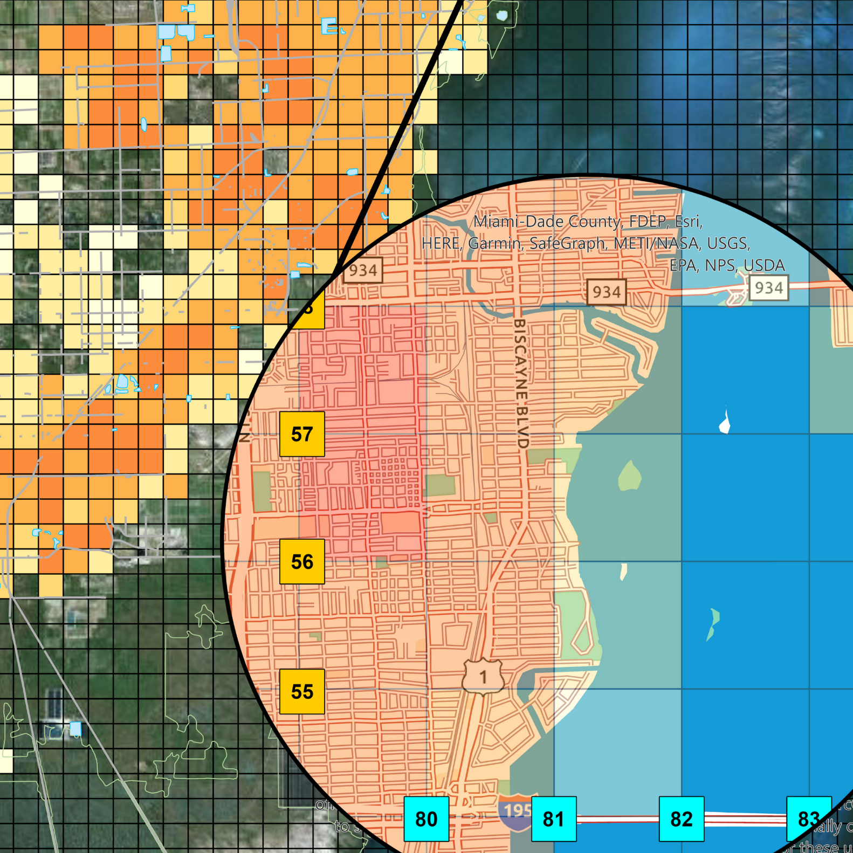
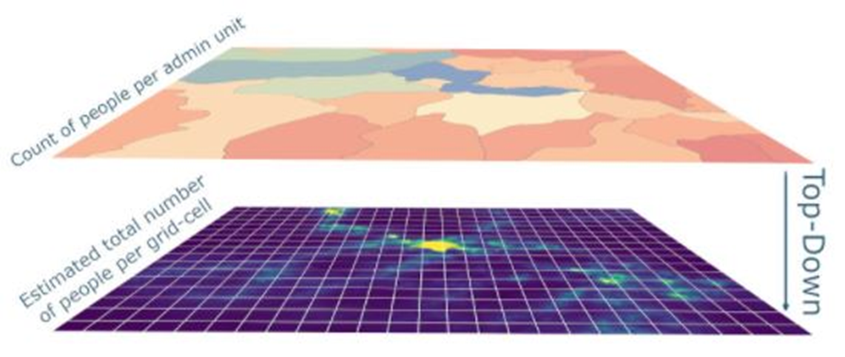
The SARtopo Project
https://usng-gis.org/docs/TheSARTopoProject.pdf
Accurate and Timely
Search-and-Rescue, First Responders, Public Safety
Small-scale Population Data
WorldPop Population Estimates
Census Tracts
1-Km US National Grid
FGDC & FEMA Standard
Southeastern United States
SARTopo
GISsurfer
ArcMap/ArcGIS Pro

Slide 35
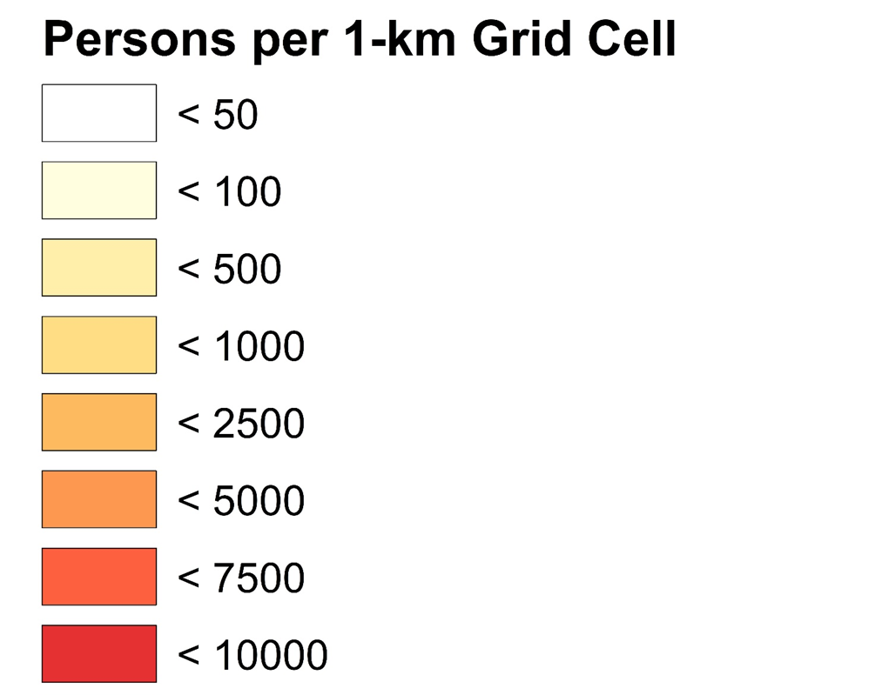
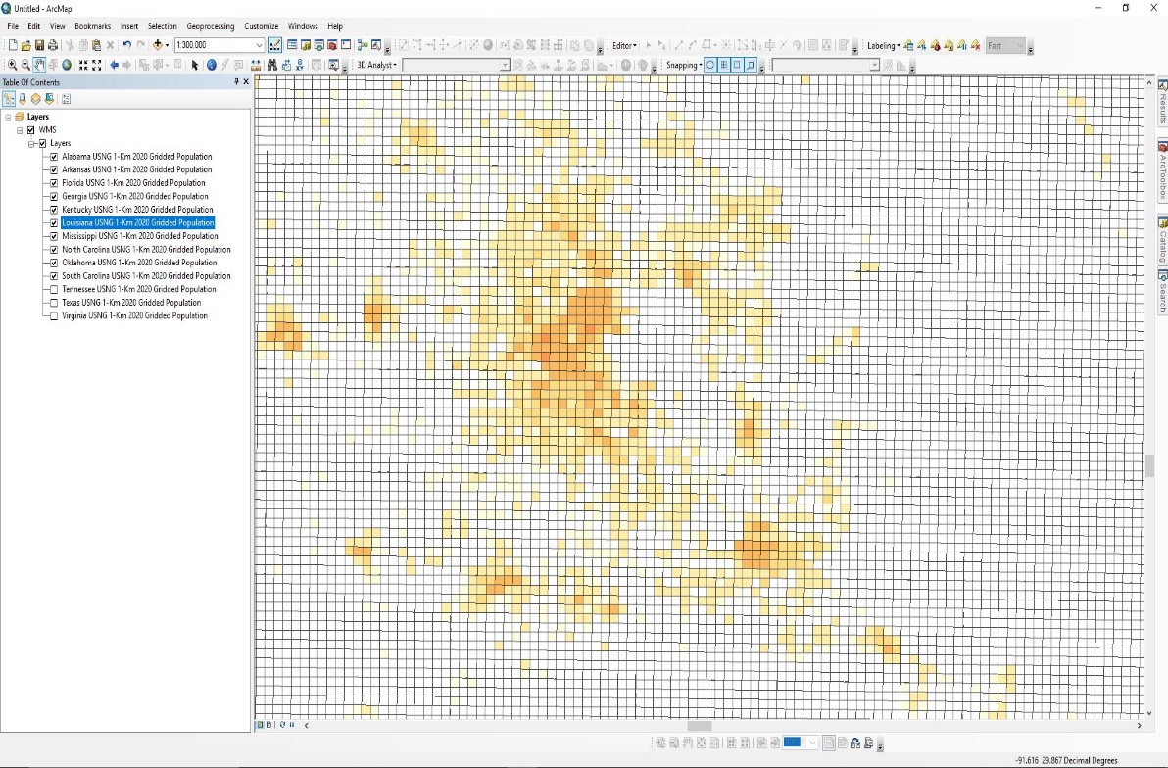
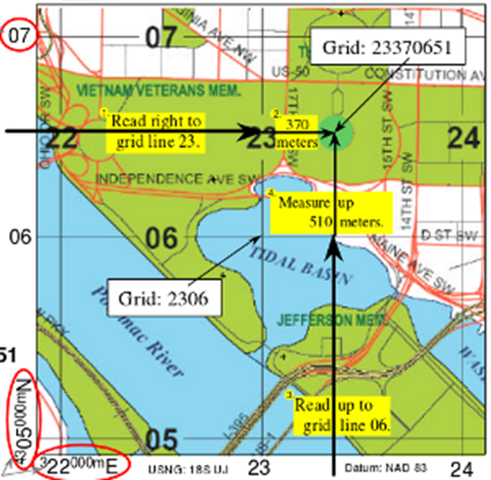
The SARtopo project
US National Grid
Gridded Population Data
Color Ramp – Choropleth Sequential Multihued Classification
To use the WMS layers in web map viewers, ArcMap and ArcGIS Online, use the WMS web-address:
https://maps2.freac.fsu.edu/arcgis/services/Sartopo/SE_USNG_Pop/MapServer/WMSServer

Slide 36
Big challenge: energy, growth, water use, land use, social vulnerability, sea level rise
https://arcg.is/19HPHG0

Slide 37
What can freac do for you?
Free data downloads
LABINS.org
usng-gis.org -> Starter Datasets
Community Health Explorer https://hermes.freac.fsu.edu/che/
The SARTopo Project https://usng-gis.org/docs/TheSARTopoProject.pdf
GIS services
Programming and Web maps
Cartography, including bi-/multi-variate visualizations
Fine-grain (gridded) maps and analysis
Bayesian network analysis
Visual analytics
If you didn’t see an example of
your problem solved here,
Remember we are affiliated with other
University professionals
who can help.

Slide 38
Questions ?! comments
Stephen Hodge, Director
shodge@fsu.edu
Georgianna Strode
gstrode@fsu.edu
Mike Core
mcore@fsu.edu
Beverly Renard
brenard@fsu.edu
freac.fsu.edu
Labins.org
hermes.freac.fsu.edu/che/
usng-gis.org
https://usng-gis.org/docs/TheSARTopoProject.pdf

